Slide 1

Introduce Cloud

Slide 2







Introduce Cloud
Cloud Computing
AWS
AWS Servies

Slide 3
I. Cloud Computing

Slide 4
I. Cloud Computing
What is Cloud Computing?
Cloud computing is the delivery of computing services, including servers, storage, databases, networking, software, analytics, and intelligence over the Internet (“the cloud”) to offer faster innovation, flexible resources, and economies of scale.
Rather than keeping files on a proprietary hard drive or local storage device, cloud-based storage makes it possible to save them to a remote database. As long as an electronic device has access to the web, it has access to the data and the software programs to run it.

Slide 5
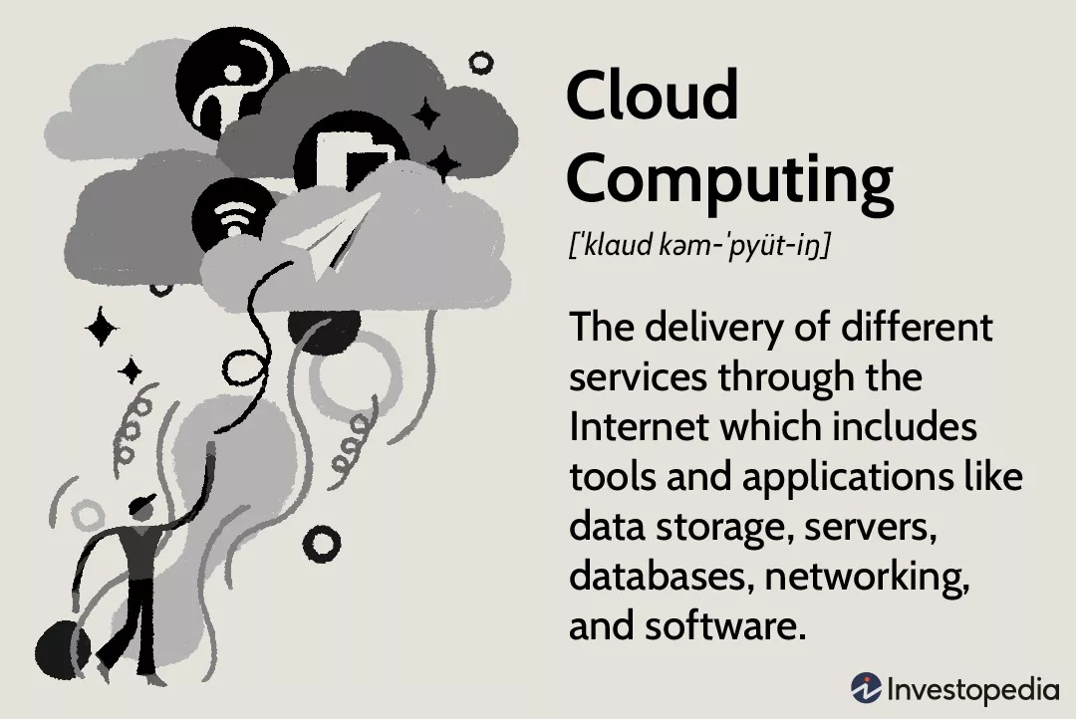
I. Cloud Computing
What is Cloud Computing?

Slide 6
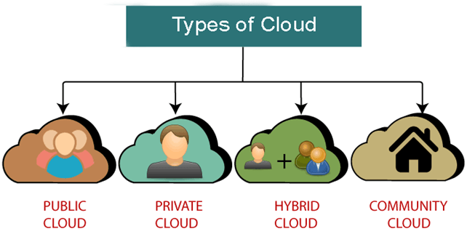
I. Cloud Computing
Types of Cloud

Slide 7
I. Cloud Computing
Types of Cloud
Public clouds provide their services on servers and storage on the Internet. These are operated by third-party companies, who handle and control all the hardware, software, and the general infrastructure. Clients access services through accounts that can be accessed by just about anyone.
Private clouds are reserved for specific clientele, usually one business or organization. The firm's data service center may host the cloud computing service. Many private cloud computing services are provided on a private network.

Slide 8
I. Cloud Computing
Types of Cloud
Hybrid clouds are, as the name implies, a combination of both public and private services. This type of model allows the user more flexibility and helps optimize the user's infrastructure and security.
Community clouds are built for the purpose of sharing infrastructure and data for many different organizations and users. For example, businesses operating in the education industry can share a cloud to exchange data for each other.

Slide 9
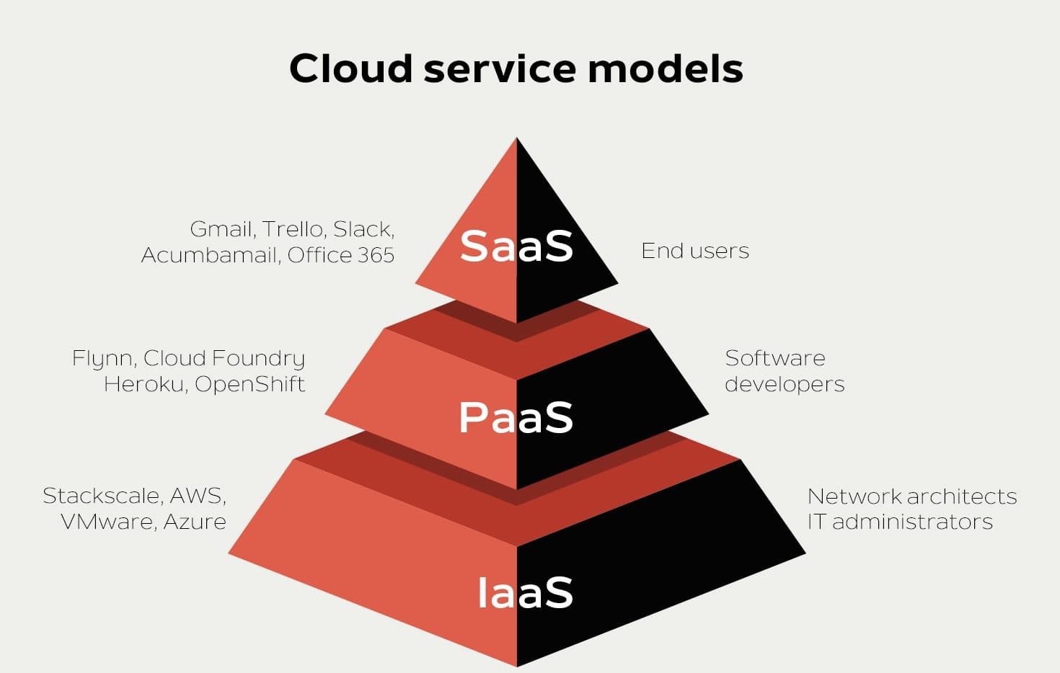
I. Cloud Computing
Cloud service models

Slide 10
I. Cloud Computing
Cloud service models
Software-as-a-service (SaaS) involves the licensure of a software application to customers. Licenses are typically provided through a pay-as-you-go model or on-demand. This type of system can be found in Microsoft Office's 365.

Slide 11
I. Cloud Computing
Cloud service models
Platform-as-a-service (PaaS) is considered the most complex of the three layers of cloud-based computing. PaaS shares some similarities with SaaS, the primary difference being that instead of delivering software online, it is actually a platform for creating software that is delivered via the Internet. This model includes platforms like Salesforce.com and Heroku.

Slide 12
I. Cloud Computing
Cloud service models
Infrastructure-as-a-service (IaaS) involves a method for delivering everything from operating systems to servers and storage through IP-based connectivity as part of an on-demand service. Clients can avoid the need to purchase software or servers, and instead procure these resources in an outsourced, on-demand service. Popular examples of the IaaS system include IBM Cloud and Microsoft Azure.

Slide 13
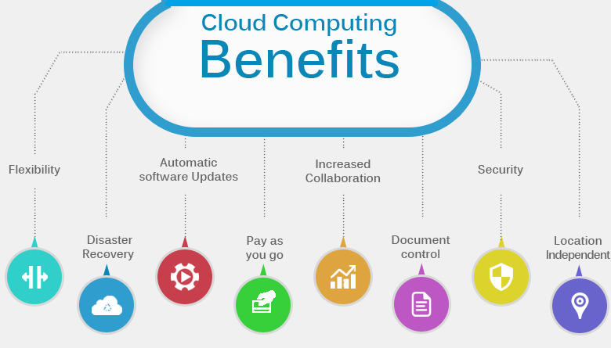
I. Cloud Computing
Cloud Computing Benefits

Slide 14
I. Cloud Computing
Cloud Computing Benefits
Cost savings: Helps minimize costs. You will not spend money on the original infrastructure. For example: Buy hardware, software, system installation, ...
Convenience: Users can quickly access and use resources via the Internet without complicated installation
Safe and continuous: All data is synchronized in the cloud. Help ensure higher safety, avoid data loss due to hard drive damage. In addition, the supplier will back up and have security methods to better protect data.
Deploy quickly anywhere: With just a few simple steps to deploy them everywhere. This means that users will get a better experience with lower latency.

Slide 15

I. Cloud Computing
Who needs to use Cloud Computing?
Cloud computing can be used for anyone:
Companies, businesses, organizations wishing to store and share data.
Website developers, applications, software.
End users (individual users).

Slide 16
I. Cloud Computing
Cloud Service providers
Google Cloud
Amazon Web Services (AWS)
Microsoft Azure
IBM Cloud
Alibaba Cloud

Slide 17
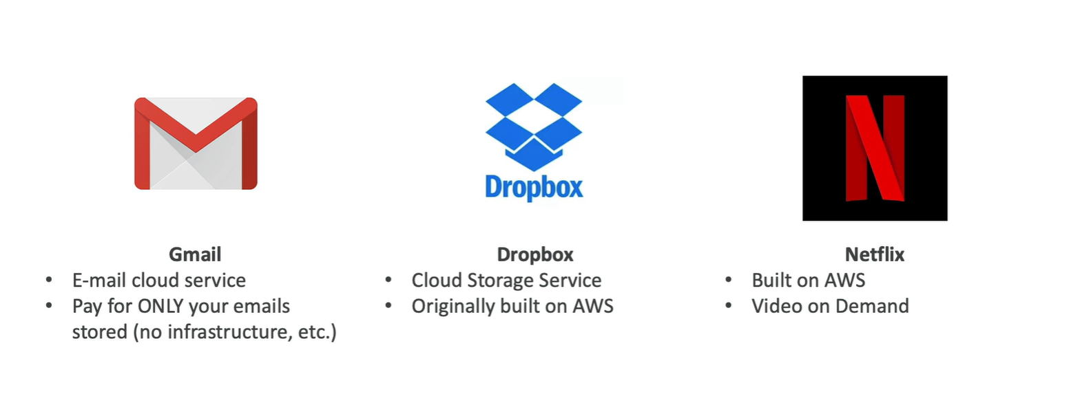
I. Cloud Computing
Example of Cloud Computing
Today, there are several examples of cloud computing applications used by both businesses and individuals. One type of cloud service would be streaming platforms for audio or video, where the actual media files are stored remotely. Another would be data storage platforms like Google Drive, Dropbox, OneDrive, or Box.

Slide 18
II. AWS

Slide 19

II. AWS
What is AWS?
AWS
AWS Meaning: The Amazon Web Services (AWS) platform provides more than 200 fully featured services from data centers located all over the world, and is the world's most comprehensive cloud platform.
Amazon web service is an online platform that provides scalable and cost-effective cloud computing solutions.
AWS is a broadly adopted cloud platform that offers several on-demand operations like compute power, database storage, content delivery, etc., to help corporates scale and grow.

Slide 20
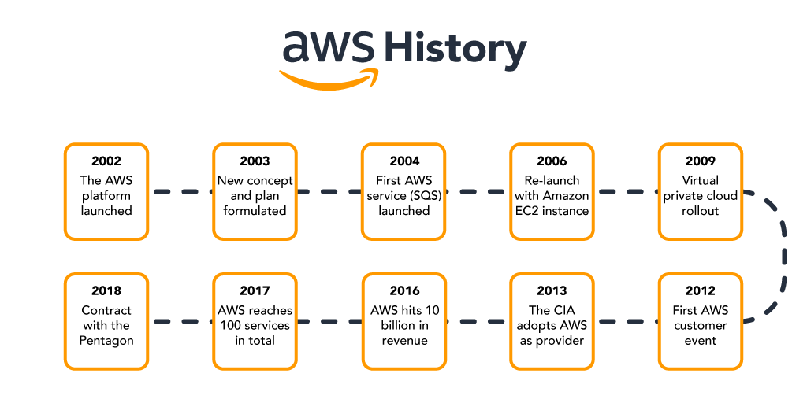
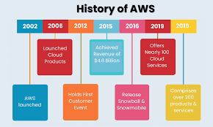
II. AWS
AWS
History of AWS

Slide 21
II. AWS
History of AWS
AWS
2002 - The platform was launched
2003 - Concept was reformulated with standardized plans
2004 - The first service (Simple Queue Service) launched for public usage
2006 - Official re-launch with Amazon EC2
2009 - Virtual Private Cloud launches
2012 - Holds first customer event
2013 - CIA adoption
2016 - Reaches 10 billion in revenue target
2017 - 100 services in total
2018 - Signs 10 billion dollar contract with the Pentagon

Slide 22
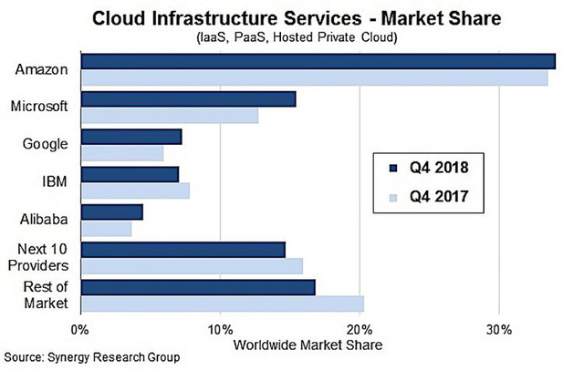
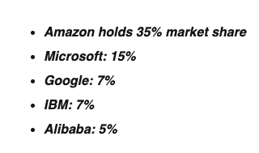
II. AWS
In 2018, the cloud compuIn 2018, the cloud computing service market thrived when businesses spent up to 70 billion USD on cloud services.ting service market thrived when businesses spent up to 70 billion USD on cloud services.
Cloud Infrastructure Services
In 2018, the cloud computing service market thrived when businesses spent up to 70 billion USD on cloud services.

Slide 23
II. AWS
AWS
Advantages of AWS
AWS provides a user-friendly programming model, architecture, database as well as operating system that has been already known to employers.
AWS is a very cost-effective service. There is no such thing as long-term commitments for anything you would like to purchase.
It offers billing and management for the centralized sector, hybrid computing, and fast installation or removal of your application in any location with few clicks.
There is no need to pay extra money on running data servers by AWS.
AWS offers a total ownership cost at very reasonable rates in comparison to other private cloud servers.

Slide 24
II. AWS
AWS
Disadvantages of AWS
AWS has supportive paid packages for intensive or immediate response. Thus, users might need to pay extra money for that.
There might be some cloud computing problems in AWS especially when you move to a cloud Server such as backup protection, downtime, and some limited control.
From region to region, AWS sets some default limitations on resources such as volumes, images, or snapshots.
If there is a sudden change in your hardware system, the application on the cloud might not offer great performance.

Slide 25
II. AWS
AWS
Applications of AWS
Application Hosting/SaaS Hosting
Sharing Media (Image/ Video)
Hosting Website
Content Delivery and Media Distribution
Social Networking
Storage, Backup, and Disaster Recovery
Development & Testing Environments
Social Networking
Academic Computing
Search Engines
Mobile and Social Applications

Slide 26
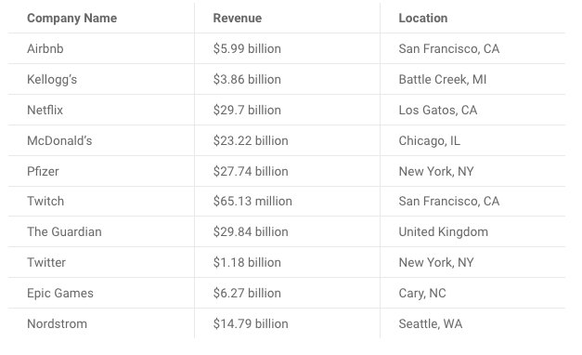
II. AWS Services
AWS
Most successful companies that use AWS

Slide 27
III. AWS Services

Slide 28
II. AWS Services
AWS
Why to use AWS Services
AWS offers more solutions and features than any other provider and has free tiers with access to the AWS Console, where users can centrally control their ministrations.
Designed around ease-of-use for various skill sets, AWS is tailored for those unaccustomed to software development utilities. Web applications can be deployed in minutes with AWS facilities, without provisioning servers or writing additional code.
Amazon hosts global data centers with a vast network ensuring reduced latency worldwide. AWS’ replication capacity allows you to duplicate services regionally, helping you recover quickly and avoid costly downtime.

Slide 29
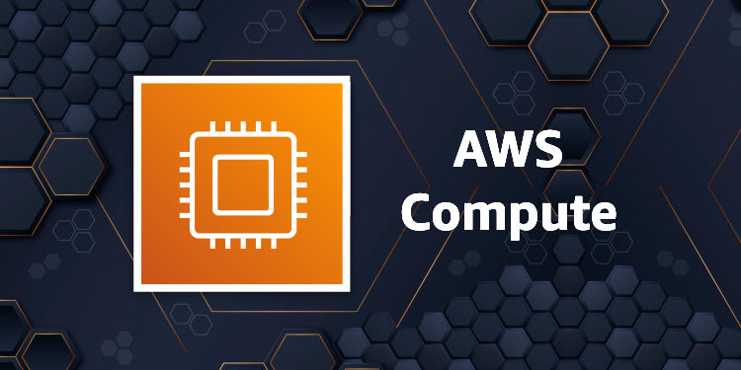
II. AWS Services
AWS
AWS Compute Services

Slide 30
II. AWS Services
AWS
AWS Compute Services
EC2 (Elastic Compute Cloud) – EC2 is a virtual machine in the cloud over which you have OS-level control. This service can run and shut down whenever needed.
LightSail – This cloud tool automatically deploys and manages the computing, storage, and networking capabilities needed to run your applications.
Elastic Beanstalk – A tool that automates deployment and provisioning of resources like a highly scalable production site.
EKS (Elastic Container Service for Kubernetes) – Tool that allows you to access Kubernetes on Amazon cloud environment without installation.
AWS Lambda – This service allows to run functions in the cloud. This tool is a big cost saver by paying only when the functions are executed.

Slide 31
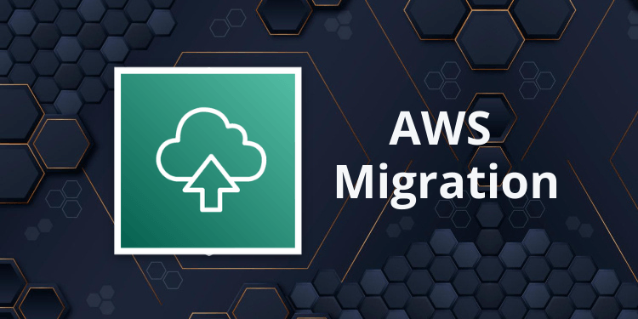
II. AWS Services
AWS
AWS Migration

Slide 32
II. AWS Services
AWS
AWS Migration
DMS (Database Migration Service) – DMS can be used to migrate on-premises databases to AWS.
SMS (Server Migration Service) – An SMS service that allows you to easily and quickly migrate on-premises servers to AWS.
Snowball – Snowball is a petabyte-scale data transport solution that uses secure appliances to transfer large amounts of data in and out of the AWS cloud .

Slide 33
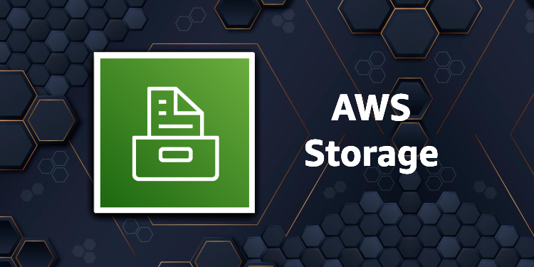
II. AWS Services
AWS
AWS Migration

Slide 34
II. AWS Services
AWS
AWS Storage Services
Amazon Glacier – This is an extremely low-cost hosting service that ensures fast and safe storage and backup of data.
Amazon Elastic Block Store (EBS) – Provides block-level storage for use with Amazon EC2 instances.
AWS Storage Gateway – This service connects on-premises software applications with cloud-based storage. Secure integration between corporate databases and AWS storage infrastructure.

Slide 35

II. AWS Services
AWS
AWS Sercurity Services

Slide 36
II. AWS Services
AWS
AWS Sercurity Services
IAM (Identity and Access Management) – IAM is a cloud security service that helps you manage users, assign policies, form groups to manage multiple users.
Inspector – This is an agent that you can install on your virtual machines, reporting any security holes.
Certificate Manager – Free SSL certificate service for your domains managed by Route53.
WAF (Web Application Firewall) – WAF security service provides application level protection and allows you to block SQL injection and help block cross-site scripting attacks.
Cloud Directory – This service allows you to create flexible, manageable root directories to decentralize data in multiple dimensions.
KMS (Key Management Service) – This is a management service. This security service helps you create and control encryption keys, which allow you to encrypt your data.
...

Slide 37
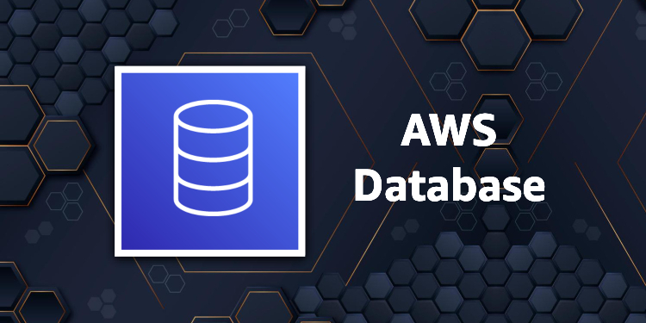
II. AWS Services
AWS
AWS Database Services

Slide 38
II. AWS Services
AWS
AWS Database Services
Amazon RDS – This service makes it easy to set up, operate, and scale a relational database in the cloud.
Amazon DynamoDB – This is a fast, fully managed NoSQL database service. It is a simple service that enables efficient data storage and retrieval.
Amazon ElastiCache – This is a web service that makes it easy to deploy, operate, and scale an in-memory cloud cache.
Neptune – This is a fast, reliable and scalable graph database service.
Amazon RedShift – This is Amazon's data warehousing solution that you can use to perform complex OLAP queries.

Slide 39

II. AWS Services
AWS
AWS Analytics Services

Slide 40
II. AWS Services
AWS
AWS Analytics Services
Athena – This analytics service allows SQL queries on S3 buckets to find files.
CloudSearch – You should use this AWS service to create a fully managed search engine for your website.
ElasticSearch – An upgraded version of CloudSearch with more features, such as application monitoring
Kinesis – This AWS analytics service helps you to stream and analyze real-time data at scale.
QuickSight – It is a business analysis tool. It helps you create in-console visualizations for data in Amazon Web Services. For example: S3, DynamoDB, etc.
EMR (Elastic Map Reduce) This AWS Analytics Service is mainly used for big data processing like Spark, Splunk, Hadoop, etc.
Data Pipeline – Allows you to move data from one place to another. For example, from DynamoDB to S3.

Slide 41
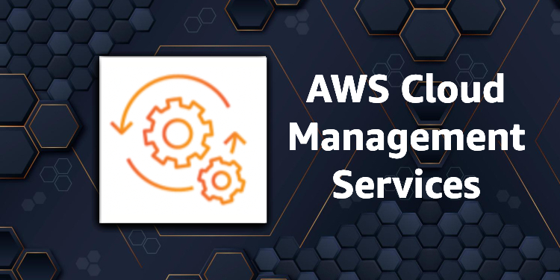
II. AWS Services
AWS
AWS Management Services

Slide 42
II. AWS Services
AWS
AWS Management Services
CloudWatch – Cloud watch helps you monitor AWS environments like EC2, RDS, and CPU usage. It also triggers alarms depending on various metrics.
CloudFormation – The service that helps set up Amazon Web Service resources, so you can spend less time managing those resources and can focus on developing applications that run on AWS .
CloudTrail – It provides an easy method to test AWS resources.
OpsWorks – Service that allows you to automatically deploy Chef/Puppet on AWS environments.
Config – The service that monitors your AWS environment. This tool will send you a notification every time you change certain configurations.
Service Catalog – This service helps large businesses to allow users to use which services and which services will not be used.
...

Slide 43
Cloud Configuration

Slide 44
Cloud Configuration
AWS EC2 Configuration
Webserver Configuration

Slide 45
I. AWS EC2 Configuration

Slide 46
I. Amazon EC2
AWS

Slide 47
I. Amazon EC2
AWS
What is Amazon EC2
Amazon Elastic Compute Cloud (Amazon EC2) is a cloud computing infrastructure powered by Amazon Web Services (AWS) that provides virtualized computing resources on demand.
Amazon EC2 provides scalable virtualized computing applications with virtual hardware components such as computer memory (ram), processors, flexibility in the choice of storage partitions data storage in different platforms and the security of service management by AWS's powerful cloud virtualization architecture.
Amazon EC2 will provide one or more virtual servers that can be combined to easily deploy the fastest application and ensure the highest availability. Even in terms of payment, you can easily know how much you need to pay based on the information about the resources you use.

Slide 48
I. Amazon EC2
AWS
What is Amazon EC2 Instance
Amazon EC2 Instanc is a cloud server. With one account you can create and use multiple Amazon EC2 Instances. Amazon EC2 Instances are run on the same physical server and share memory, CPU, hard drive...

Slide 49
I. Amazon EC2
AWS
What is Amazon EC2 Feature
Scaling:
Scaling Up/Down: Increase/Decrease capacity(RAM, CPU,...) of Instance.
Scaling In/Out: Increase/Decrease the number of Instances.
Security:
It is possible to set a private IP rank exclusively for EC2.
Use Security Group and Network ACLS to control inbound/outbound.
An IPsec VPN can be established between Data Center and AWS Cloud.
Delicated Instance -> Create EC2 on a single physical hardware for a single customer.
Cost:
On-Demand Instance: Calculated by the hour, meeting the needs of use in a short time. Use as much, pay as much.
Reserved Instance: Allows to prepay a server amount for 1 or 3 years. The cost is only 75% of On-Demand. If you don't need to use it for a long time, you can sell it at the Reserved Instance Marketplace

Slide 50
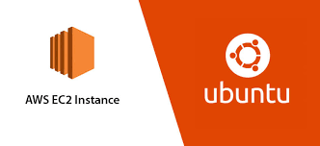
I. Amazon EC2
Amazon EC2 Instance Configuration
Amazon EC2 Instanc is a cloud server. With one account you can create and use multiple Amazon EC2 Instances. Amazon EC2 Instances are run on the same physical server and share memory, CPU, hard drive...

Slide 51
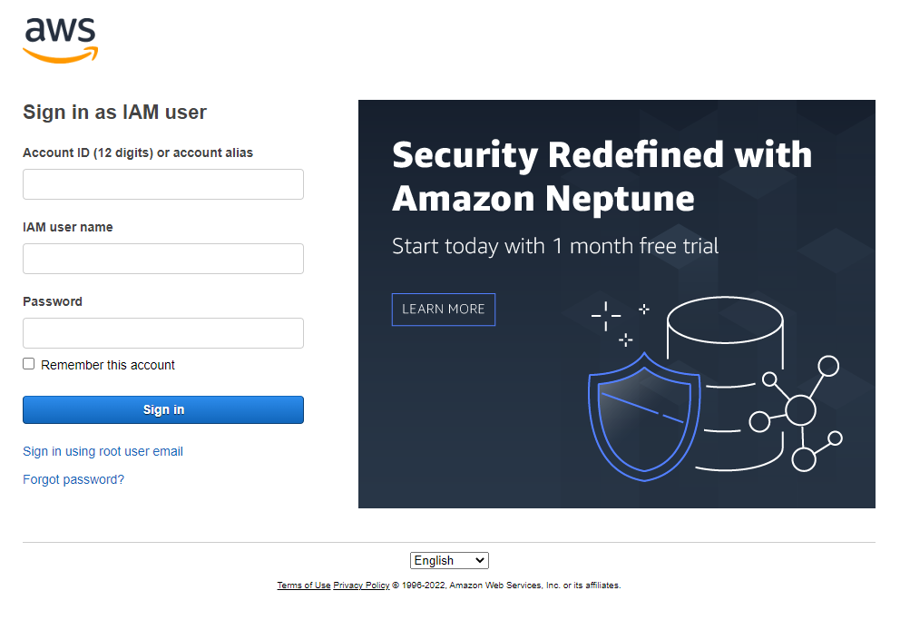
I. EC2 Instance Configuration
AWS
1. Sign in to the AWS Management Console and open the Amazon EC2 console at https://console.aws.amazon.com/ec2/

Slide 52
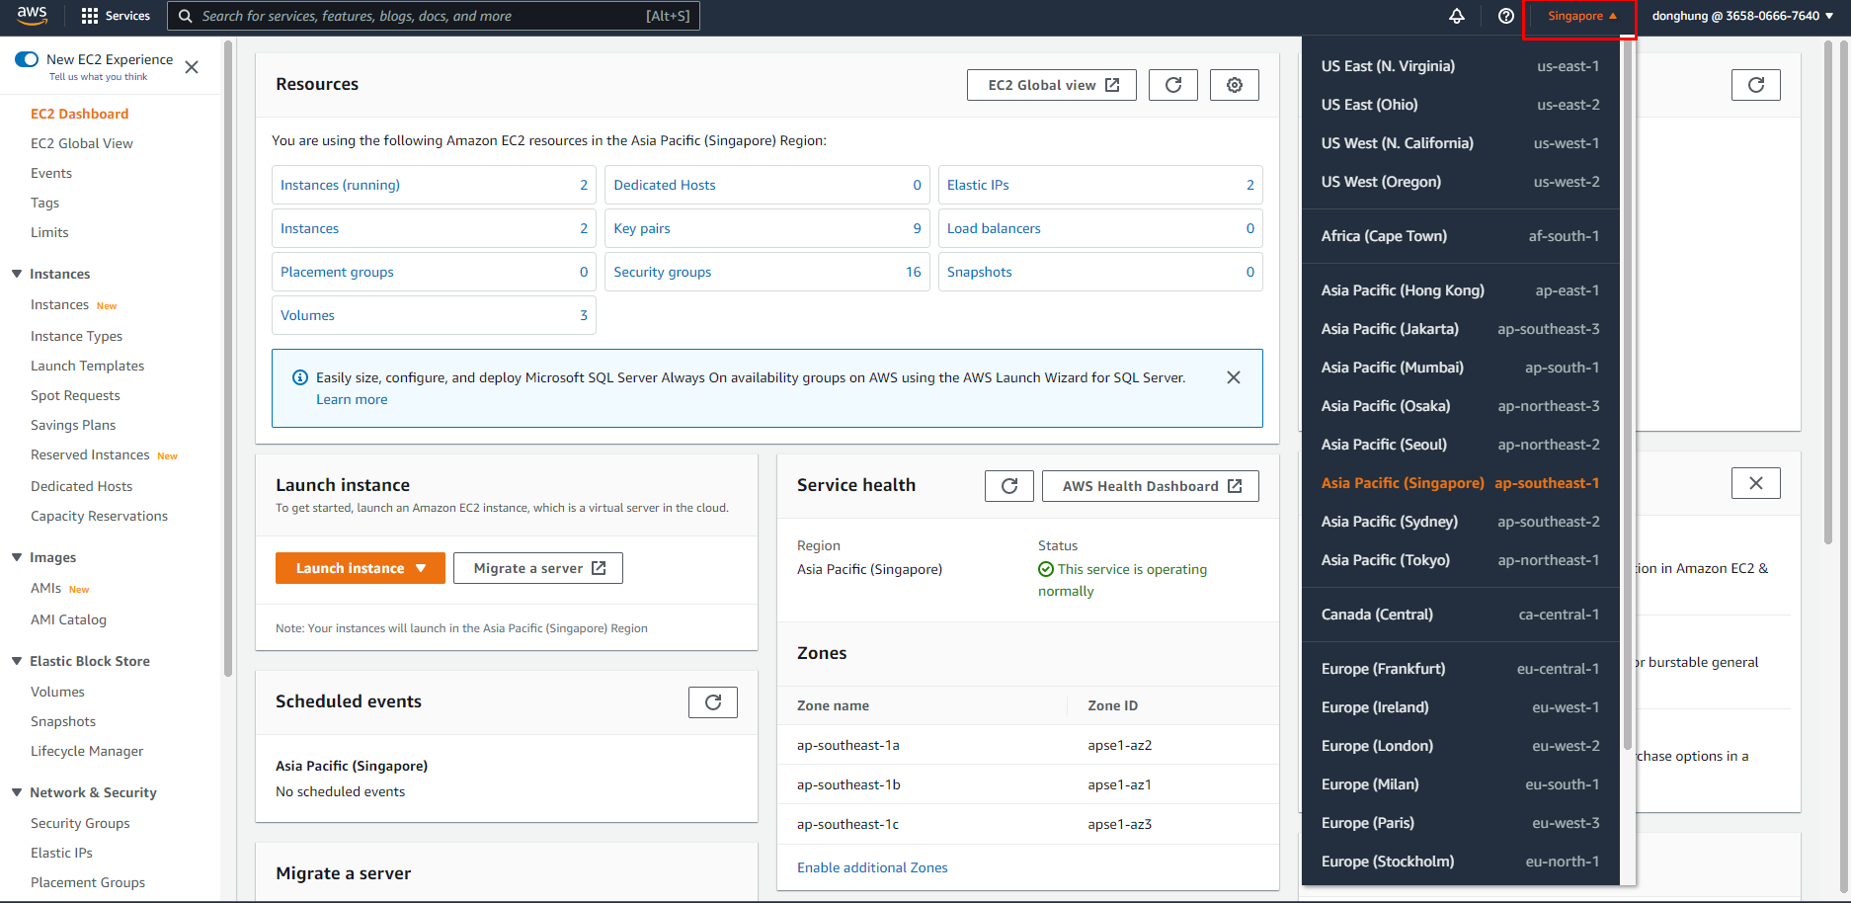
I. EC2 Instance Configuration
AWS
2. In the upper-right corner of the AWS Management Console, choose the AWS Region where you want to create the EC2 instance.

Slide 53
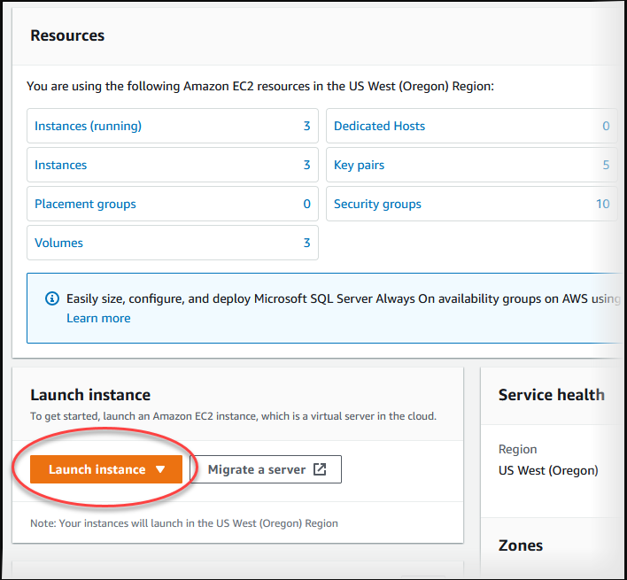
I. EC2 Instance Configuration
AWS
3. Choose EC2 Dashboard, and then choose Launch instance, as shown following.

Slide 54
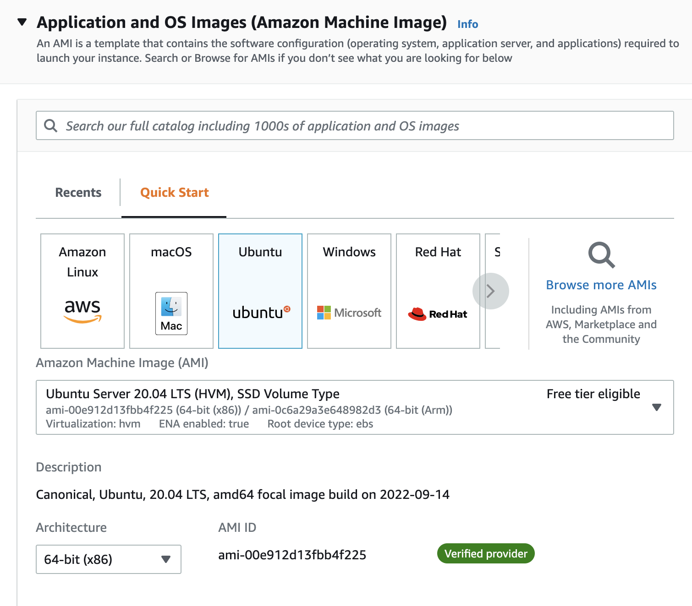
I. EC2 Instance Configuration
AWS
4. Make sure you have opted into the new launch experience.
5. Under Name and tags, for Name, enter the name what your want. My instance’name is “NGINX”
6 .Under Application and OS Images (Amazon Machine Image), choose OS and AMI. You should choose Ubuntu and Ubuntu Server 20.04 LTS

Slide 55
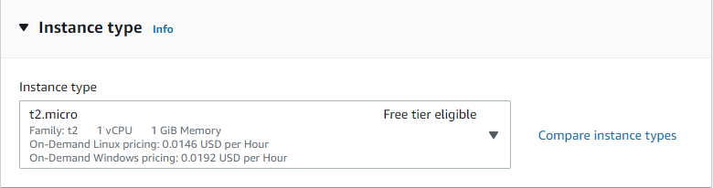
I. EC2 Instance Configuration
AWS
7. Under Instance type, you should choose t2.micro.

Slide 56
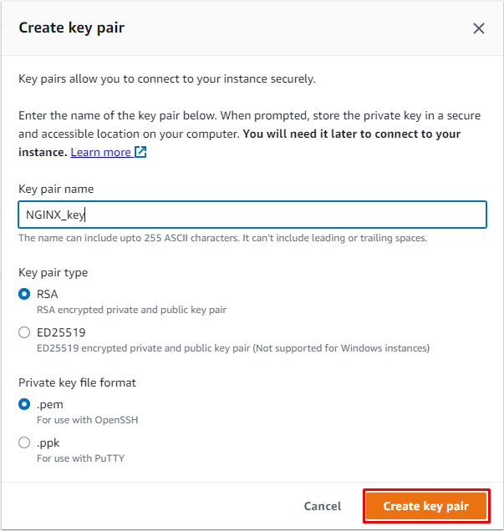
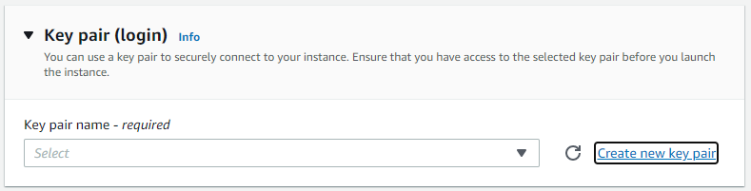
I. EC2 Instance Configuration
AWS
8. Under Key pair (login) choose Create new key pair and then use the Create key pair window to create it..
Remember you key pair name and it’s location.

Slide 57
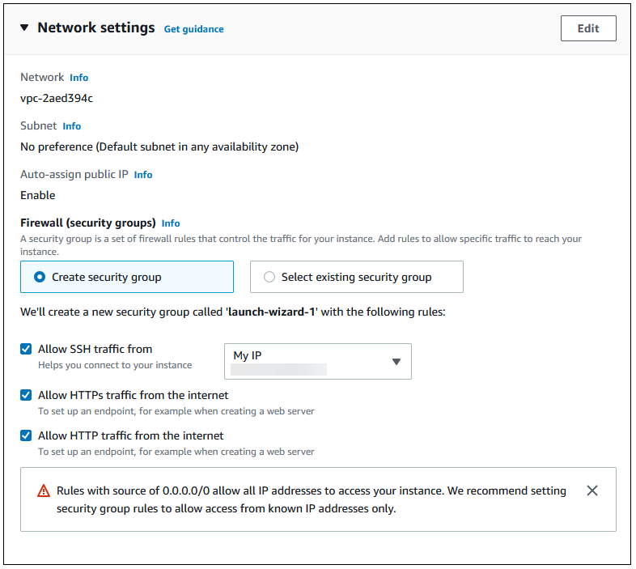
I. EC2 Instance Configuration
AWS
9. Under Network settings, set these values and keep the other values as their defaults:
For Allow SSH traffic from, choose the source of SSH connections to the EC2 instance.
You can choose My IP if the displayed IP address is correct for SSH connections.
Turn on Allow HTTPs traffic from the internet.
Turn on Allow HTTP traffic from the internet.

Slide 58
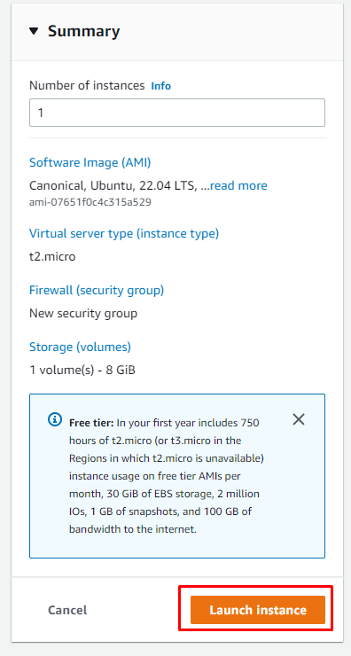
I. EC2 Instance Configuration
AWS
10. Leave the default values for the remaining sections.
11.Review a summary of your instance configuration in the Summary panel, and when you're ready, choose Launch instance.

Slide 59
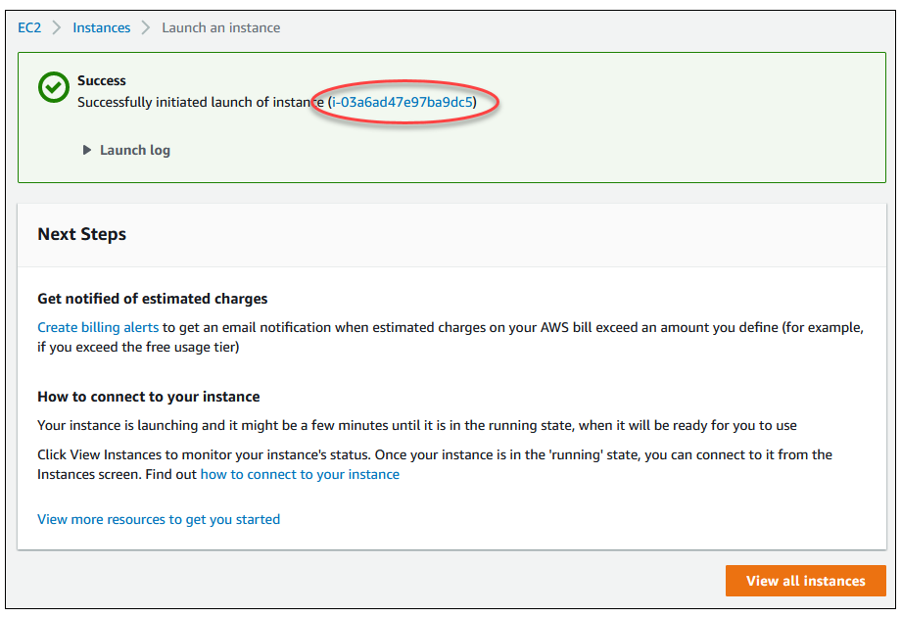
I. EC2 Instance Configuration
AWS
12. On the Launch Status page, shown following, note the identifier for your new EC2 instance, for example: i-03a6ad47e97ba9dc5

Slide 60
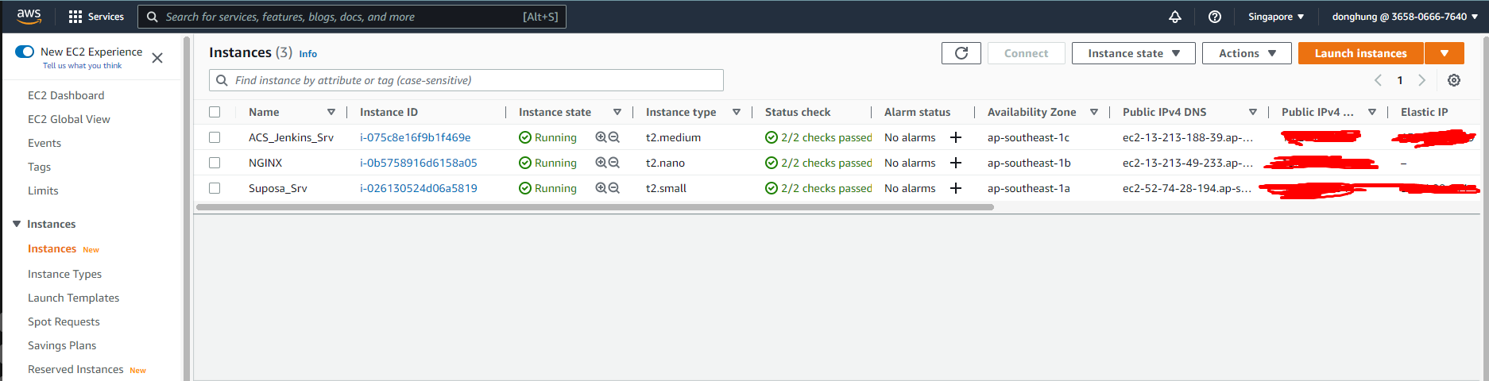
I. EC2 Instance Configuration
AWS
13. Choose View all instances to find your instance.
14. Wait until Instance state for your instance is Running.

Slide 61
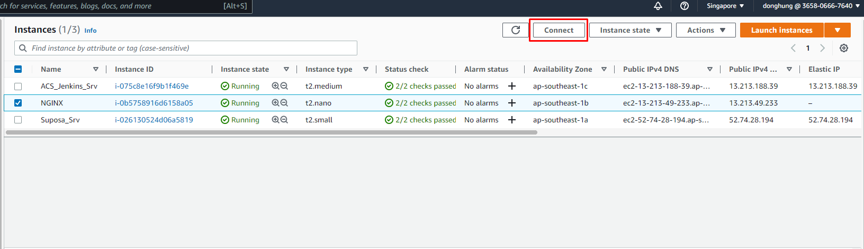
II. EC2 Webserver Configuration
AWS
15. Click the Connect button at the top of the screen. A window like the following pops up. Open the SSH client tab and follow the instructions to connect to the instance

Slide 62
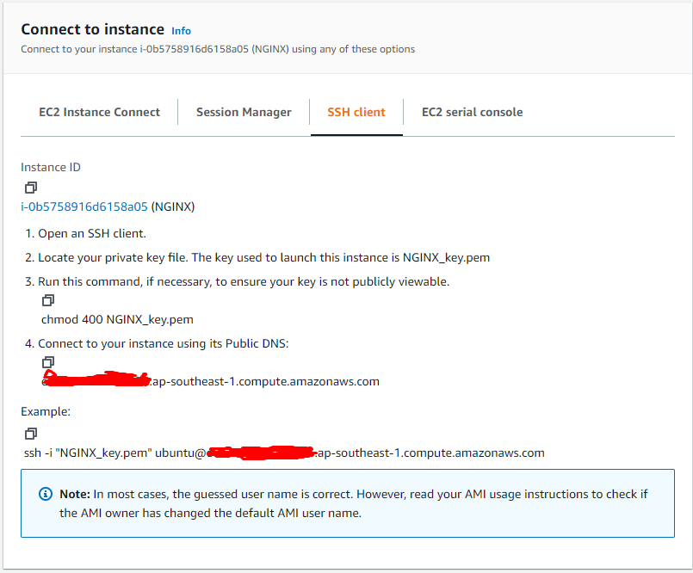
II. EC2 Webserver Configuration
AWS
15. Follow the command in this tab

Slide 63
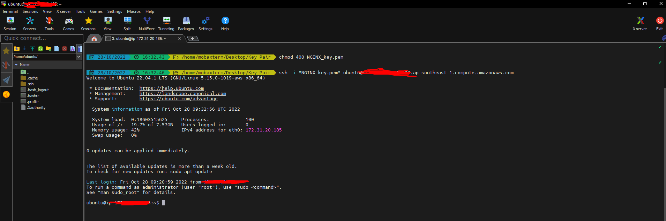
II. EC2 Webserver Configuration
AWS
16. If you use “Window”. Please download a ssh tool to connect Instance.
https://mobaxterm.mobatek.net/download.html
Open the browser at the folder containing the key pair file and execute the command in SSH Tab
Now, you have access to your instance

Slide 64
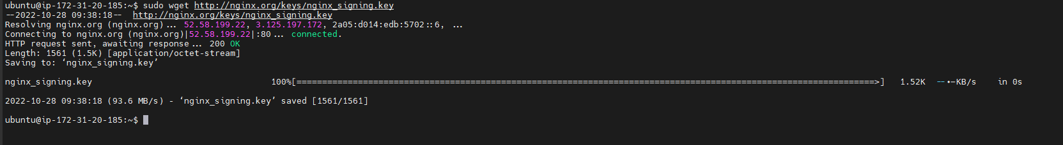
II. EC2 Webserver Configuration
AWS
17. Download the NGINX signing key:
sudo wget http://nginx.org/keys/nginx_signing.key

Slide 65
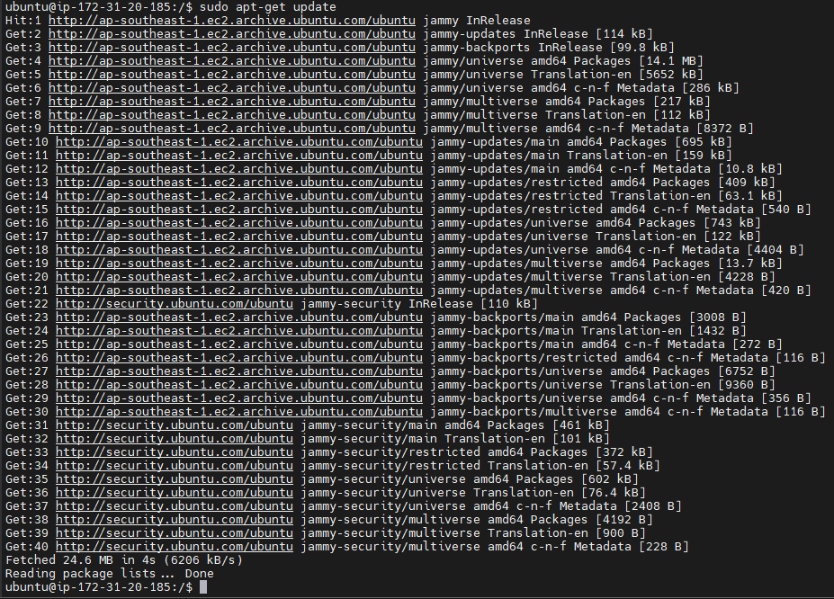
II. EC2 Webserver Configuration
AWS
18. Update software:
sudo apt-get update

Slide 66
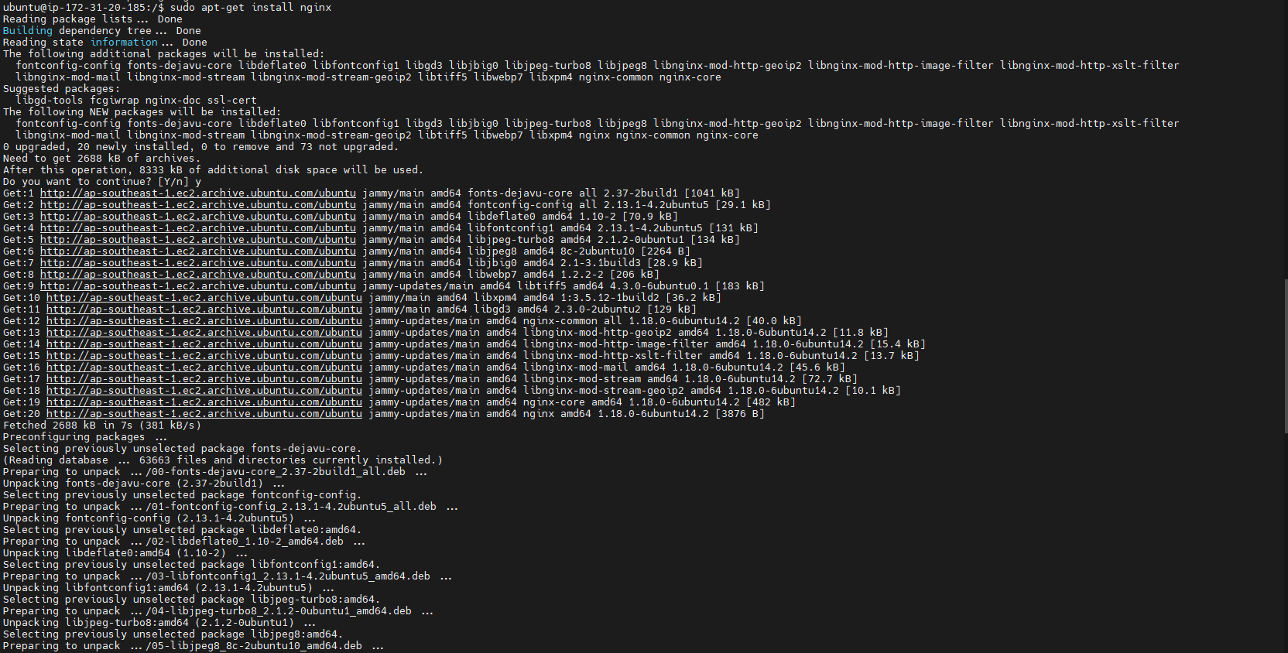
II. EC2 Webserver Configuration
AWS
19. Install NGINX:
sudo apt-get install nginx
Type Y when prompted.

Slide 67
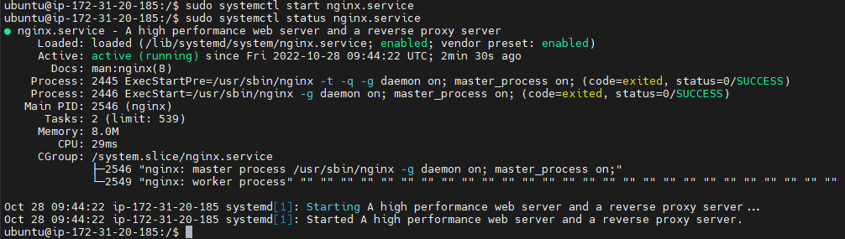
II. EC2 Webserver Configuration
AWS
20. Start NGINX
sudo systemctl start nginx.service
21. Check it’s status
sudo systemctl status nginx.service

Slide 68
Cloud Operation

Slide 69
Cloud Operator
AWS Auto Scaling
Basic Load Balancing
Log Aggregator & Monitoring

Slide 70
I. AWS Auto Scaling

Slide 71
I. AWS Auto Scaling
AWS
What is AWS Auto Scaling?
AWS Auto Scaling is an automatic scaling feature that ensures that Amazon EC2 instances are Scalingsufficient to run your applications
You can create an AWS Auto Scaling bucket in EC2 instances
You can specify a minimum number of EC2 instances in that pool, and autoscaling will maintain and guarantee a minimum number of EC2 instances.
Using scaling policy, AWS Auto Scaling can launch or terminate EC2 instances as needed

Slide 72
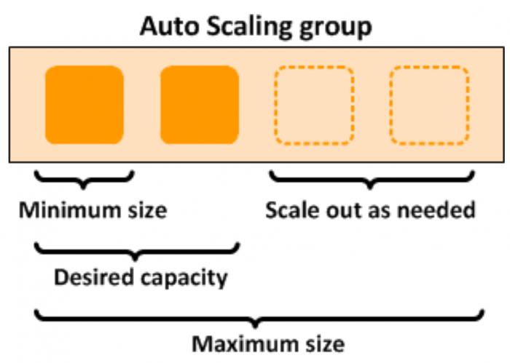
I. AWS Auto Scaling
AWS
What is AWS Auto Scaling?

Slide 73

I. AWS Auto Scaling
AWS
AWS Auto Scaling Components - Groups
Groups are logical groups containing a collection of EC2 instances with similar characteristics for scalability and management purposes
Using auto-scaling pools, you can increase the number of EC2 instances to improve your application performance, and you can also reduce the number of EC2 instances depending on traffic to reduce costs
AWS Auto Scaling also maintains a certain number of EC2 instances even if one EC2 instance is not good enough to meet demand.

Slide 74

I. AWS Auto Scaling
AWS
AWS Auto Scaling Components - Launch Configuration
The launch configuration is a template used by autoscaling groups (groups) to launch EC2 instances.
You can specify Amazon Machine Image (AMI), instance type, key pair, and security group, etc. while creating launch configuration
You can also modify the launch configuration after creation.
The launch configuration can be used for multiple AWS Auto Scaling groups.

Slide 75
I. AWS Auto Scaling
AWS
AWS Auto Scaling Components - Expansion plan
The scaling plan shows when and how to use AWS Auto Scaling
Amazon EC2 auto-scaling provides several ways for you to scale your AWS Auto Scaling groups

Slide 76
I. AWS Auto Scaling
AWS
Maintainability and scalability
Automatic manual expansion: With this mode, you specify changes in the maximum, minimum or desired capacity of auto-expanding groups. Auto-scaling maintains versions with up-to-date capabilities.
Auto-expand on schedule: You can create a scheduled action that requires Amazon EC2 to automatically scale to perform a scaling action based on a specific time
Ex: During limited offers or specific days of high traffic, in such cases you can scale your app based on scheduled rates
Auto-scaling on demand: This is the most advanced AWS Auto Scaling model using scaling policy. Based on specific parameters, you can expand or shrink your resources. You can create policies by defining parameters like CPU usage, Memory, Network I/O, etc.
Ex: you can automatically scale EC2 beyond CPU usage greater than 70%. If CPU usage crosses this threshold value, auto-scaling will launch new instances using the launch configuration

Slide 77

AWS Auto Scaling Configuration
AWS

Slide 78
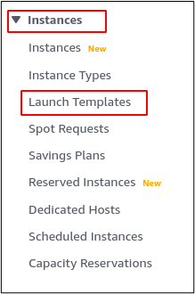
AWS Auto Scaling Configuration
AWS
1. Create a launch template
From the left side panel, go to the Launch Templates under the Instances section.
Click on the Create launch template button to create a new launch template, and it will open a form asking for different parameters for the launch template.

Slide 79
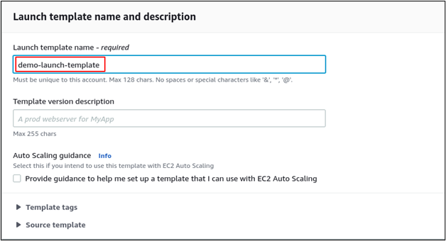
AWS Auto Scaling Configuration
AWS
1. Create a launch template
Enter the Launch template name under the Launch template name and description section.

Slide 80
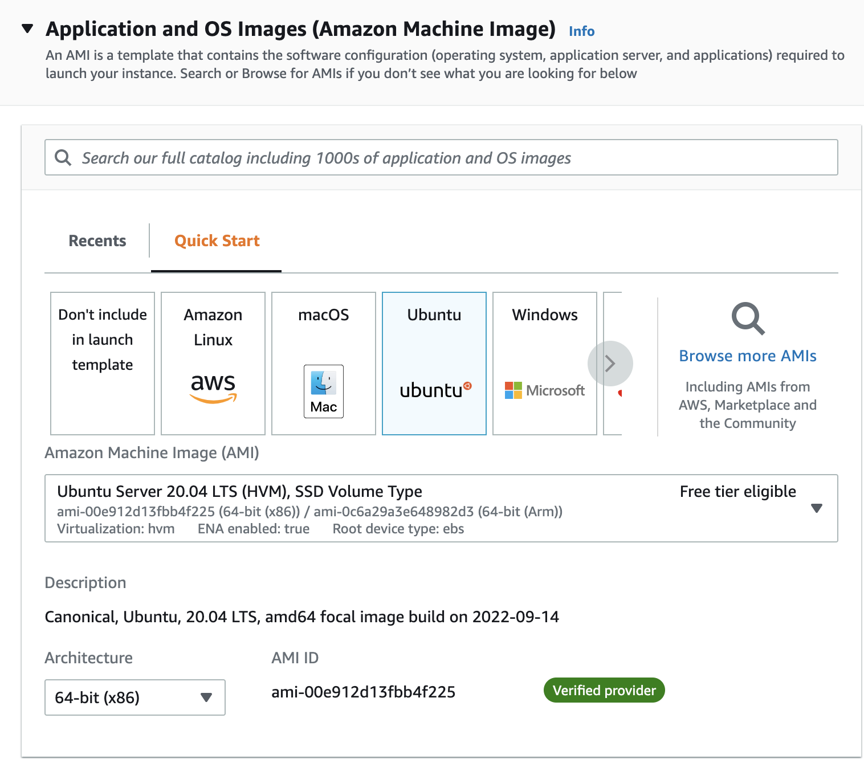
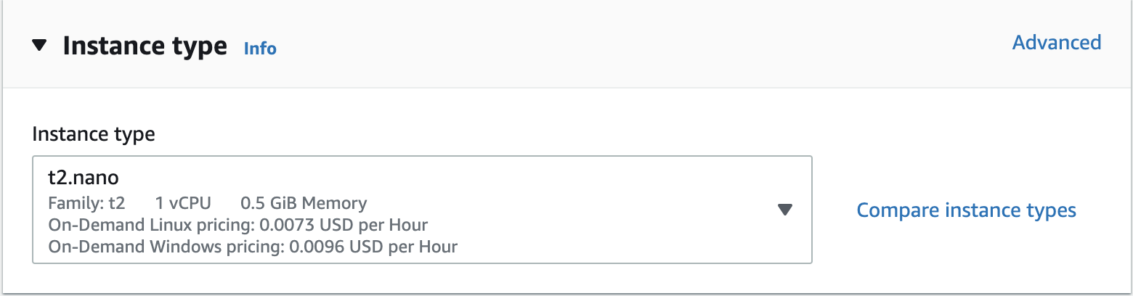
AWS Auto Scaling Configuration
AWS
1. Create a launch template
Select the AMI under the Amazon machine image and the Instance type under the Instance type section.

Slide 81
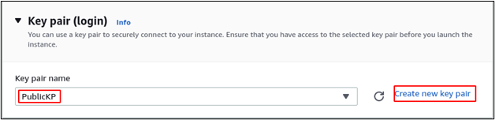
AWS Auto Scaling Configuration
AWS
1. Create a launch template
Select the specific Key pair you want to use while logging into your server over SSH. If you do not have any key, create one by clicking on the Create new key pair.

Slide 82
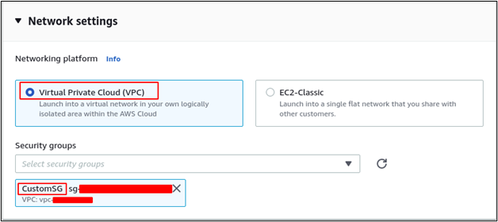
AWS Auto Scaling Configuration
AWS
1. Create a launch template
Under the Network settings, select the Networking platform and security groups.

Slide 83
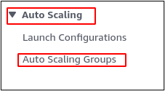
AWS Auto Scaling Configuration
AWS
2. Create an auto-scaling group from the launch template
After creating the launch template, now create the auto-scaling group from the launch template. From the left side panel, click on the Auto Scaling Groups under the Auto Scaling section.
Click on the Create Auto Scaling group to create a new auto-scaling group.

Slide 84
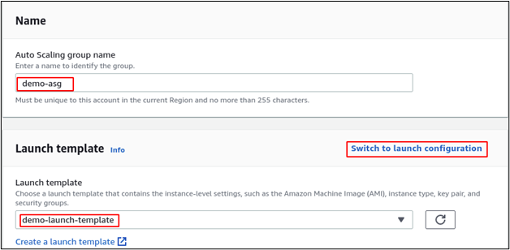
AWS Auto Scaling Configuration
AWS
2. Create an auto-scaling group from the launch template
Enter the name of the auto-scaling group and select the launch template created in the previous step

Slide 85
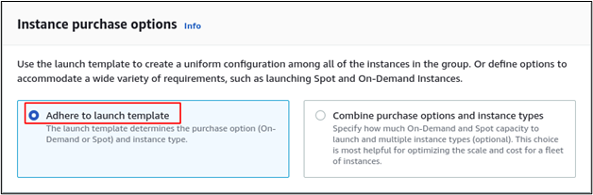
AWS Auto Scaling Configuration
AWS
2. Create an auto-scaling group from the launch template
Click on the Next button after entering the above details, and it will ask for the instant purchase option and network details. Select the Adhere to launch template as an instant purchase option.

Slide 86
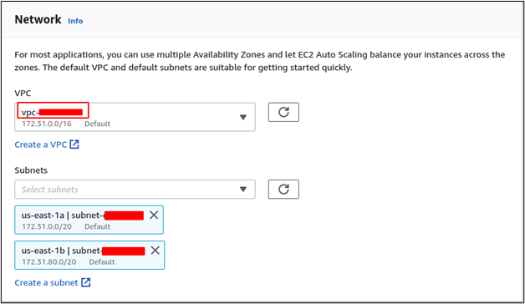
AWS Auto Scaling Configuration
AWS
2. Create an auto-scaling group from the launch template
For the network, select the VPC and subnets you want to deploy instances in. For this guide, we will use default VPC and two subnets. You can select as many subnets as you want.

Slide 87
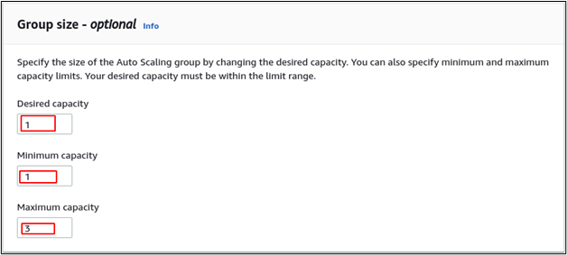
AWS Auto Scaling Configuration
AWS
2. Create an auto-scaling group from the launch template
After entering the network details, click on the Next button, and it will ask for the advanced options. Click on the Next button without entering or selecting any parameter, and it will ask for group size and scaling policy

Slide 88
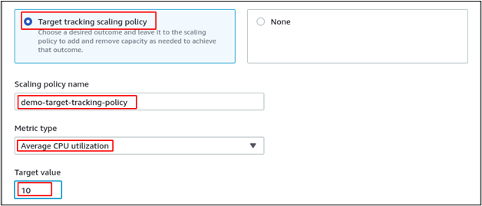
AWS Auto Scaling Configuration
AWS
2. Create an auto-scaling group from the launch template
Select Target tracking scaling policy, enter the Scaling policy name, select Average CPU utilization as Metric type, and 10 as Target value.
Now click on the Skip to review button to skip the remaining steps and click on the Create auto scaling group button at the end of the page after reviewing the configuration to create the auto scaling group.

Slide 89
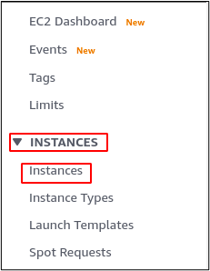
AWS Auto Scaling Configuration
AWS
3. Test auto scaling group
First, we will test the auto scaling group by terminating the EC2 instance. From the left side, the panel selects the Instances under the INSTANCES section.

Slide 90
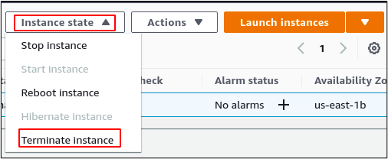
AWS Auto Scaling Configuration
AWS
3. Test auto scaling group
Select the instance launched by the auto scaling group and click on the Instance state button on the top right corner. It will open a list, click on the Terminate instance to terminate the instance manually.

Slide 91
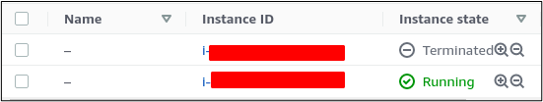
AWS Auto Scaling Configuration
AWS
3. Test auto scaling group
After 3 minutes of terminating the instance, the auto-scaling group will launch a new instance.

Slide 92

AWS Auto Scaling Configuration
AWS
3. Test auto scaling group
Another way to test the auto scaling group is to increase the load on the EC2 instance, as we have configured the CPU utilization as a metric of the scaling policy. Whenever the load on the CPU goes above 10%, the auto-scaling group will launch another EC2 instance. For this purpose, SSH into the EC2 instance and run an infinite loop (SSH into instance has been guided in the previous section)
On the terminal, run the following command: while true; do echo "Hi"; sleep 1; done

Slide 93

AWS Auto Scaling Configuration
AWS
3. Test auto scaling group
It will run an infinite loop, and the CPU utilization will reach a maximum that will trigger the auto-scaling group to launch another instance. Go to the instances section to see the instances.

Slide 94

AWS Auto Scaling Configuration
AWS
4. Delete auto scaling group
Select the Auto Scaling Groups from the EC2 console.

Slide 95

AWS Auto Scaling Configuration
AWS
4. Delete auto scaling group
Select the auto scaling group and click on the Edit button.

Slide 96

AWS Auto Scaling Configuration
AWS
4. Delete auto scaling group
Set the desired capacity and the minimum capacity to 0 and click on the Update button at the end of the page.

Slide 97

AWS Auto Scaling Configuration
AWS
4. Delete auto scaling group
It will automatically terminate all the instances launched by the auto scaling group to maintain the size of the group. Go to the instances section to see all the instances available

Slide 98

AWS Auto Scaling Configuration
AWS
4. Delete auto scaling group
Both the instances are terminated, and now the auto-scaling group can be deleted. From the auto scaling group section, select the auto scaling group and click on the Delete button.

Slide 99

AWS Auto Scaling Configuration
AWS
4. Delete auto scaling group
Now it will ask for your confirmation to delete the auto scaling group. Enter delete in the input bar and click on the Delete button to delete the auto scaling group.

Slide 100

AWS Auto Scaling Configuration
AWS
4. Delete auto scaling group
After deleting the auto scaling group, go to the launch template section to delete the launch template.

Slide 101

AWS Auto Scaling Configuration
AWS
4. Delete auto scaling group
Select the launch template and click on the Actions button. It will display a list of different options. Select the Delete template option from the list.

Slide 102

AWS Auto Scaling Configuration
AWS
4. Delete auto scaling group
Now it will ask for confirmation before deleting the launch template. Enter delete in the input bar and click on the Delete button to delete the launch template.

Slide 103
II. Basic Load Balancing

Slide 104

II. Basic load balancing
AWS
What is Elastic load balancer
Elastic load balancer is a service provided by Amazon in which the incoming traffic is efficiently automatically distributed across a group of backend servers in a manner that increases speed and performance.
It helps to improve scalability of your application and secures your applications.
Load Balancer allows you to configure health checks for the registered targets. In case any of registered target fails the health check, the load balancer will not route traffic to that unhealthy target. Thereby ensuring your application is highly available and fault tolerant.

Slide 105
Types of load balancer
AWS
1. Classic Load Balancer
It is the traditional form of load balancer which was used initially.
It distributes the traffic among the instances and is not intelligent enough to support host-based routing or path-based routing.
It ends up reducing efficiency and performance in certain situations.
It is operated on connection level as well as request level. Classic
Load Balancer is in between the transport layer (TCP/SSL) or the application layer (HTTP/HTTPS ).

Slide 106
Types of load balancer
AWS
2. Application Load Balancer
This type of Load Balancer is used when decisions are to be made related to HTTP and HTTPS traffic routing.
It supports path-based routing and host-based routing.
This load balancer works at the Application layer of the OSI Model. The load balancer also supports dynamic host port mapping.

Slide 107
Types of load balancer
AWS
3. Network Load Balancer
This type of load balancer works at the transport layer(TCP/SSL) of the OSI model.
It’s capable of handling millions of requests per second.
It is mainly used for load balancing TCP traffic.

Slide 108
Types of load balancer
AWS
4. Gateway Load Balancer
Gateway Load Balancers provides you the facility to deploy, scale, and manage virtual appliances like firewall.
Gateway Load Balancers combines a transparent network gateway and then distributes the traffic.

Slide 109

Configure an Application load balancer
AWS
1. Creating target groups
From the left side panel, go to the Target Groups section.

Slide 110

Configure an Application load balancer
AWS
1. Creating target groups
From the top right corner of the console, click on the create target group button to create a new target group.

Slide 111

Configure an Application load balancer
AWS
1. Creating target groups
Now it will ask for the target type you want to register in this target group. Select the Instances as target types for this target group.

Slide 112

Configure an Application load balancer
AWS
1. Creating target groups
Now it will ask for the target group name, port, protocol, HTTP Version, and VPC. The target group name is a unique identifier that identifies the target group in a VPC.

Slide 113

Configure an Application load balancer
AWS
1. Creating target groups
Now keep the health check settings as default and click on the Next button to register the targets for the target group.
It will display all the instances in the VPC, and you can register any number of instances from here. We will register only one EC2 instance in this target group. Select the instance you want to register and enter the port on which the server is running inside the instance. Click on the include as pending below button to register the target in the target group.

Slide 114
Configure an Application load balancer
AWS
1. Creating target groups
After registering the target, click on the create target group button to create the target group with EC2 instance registered.

Slide 115

Configure an Application load balancer
AWS
2. Creating application load balancer
After creating the target group for the load balancer, now go to the Load balancers from the left side panel.

Slide 116

Configure an Application load balancer
AWS
2. Creating application load balancer
After creating the target group for the load balancer, now go to the Load balancers from the left side panel.
Click on the create load balancer button.

Slide 117

Configure an Application load balancer
AWS
2. Creating application load balancer
It will open a new web page to select the load balancer type to create. Select the application load balancer and click on the create button.

Slide 118

Configure an Application load balancer
AWS
2. Creating application load balancer
Now it will ask for the basic configuration of the application load balancer. Enter the Load balancer name, scheme, and IP address type. Load balancer name is a unique identifier for the application load balancer to be created.

Slide 119

Configure an Application load balancer
AWS
2. Creating application load balancer
Now for networking, select the VPC, availability zones, and subnets from availability zones. The VPC must be the same as selected while creating the target group.

Slide 120

Configure an Application load balancer
AWS
2. Creating application load balancer
For the security group, select a security group from the VPC that will control inbound and outbound traffic from the application load balancer.

Slide 121

Configure an Application load balancer
AWS
2. Creating application load balancer
After configuring VPC and security group, now configure the default listener for the application load balancer.
The demo-tg target group is configured to equally pass the traffic to port 80 of the EC2 instances inside it.

Slide 122

Configure an Application load balancer
AWS
2. Creating application load balancer
After configuring the load balancer, now have a look at the configuration summary and click on the create load balancer to create the load balancer.

Slide 123
III. Log Aggregator & Monitoring

Slide 124
III. Log Aggregator & Monitoring
AWS
What is CloudWatch?
CloudWatch is a service used to monitor your AWS resources and the applications that you run on AWS in real time. CloudWatch is used to collect and track your application and resource metrics.
It automatically displays metrics for every AWS service you select.
You can create a dashboard to display metrics about your custom app and also display metrics from a custom collection of your choice.
You can also create alarms to see metrics. For example, you can monitor the CPU usage, disk reads, and writes of your Amazon EC2 instances to determine if additional EC2 instances(entities) are required to handle the load. It can also be used to stop instances to save money.

Slide 125
III. Log Aggregator & Monitoring
AWS
The components of Cloudwatch
Dashboards : CloudWatch is used to create dashboards to show what's happening with your AWS environment.
Alarms : It allows you to set alarms to notify you whenever a specific threshold is reached .
Logs : CloudWatch Logs helps you to aggregate, monitor, and store logs.
Events : CloudWatch helps you respond to state changes to your AWS resources.

Slide 126

Create Cloudwatch Dashboard
AWS
1. From the AWS Console, click the search box and type in CloudWatch (or you can open this link directly https://console.aws.amazon.com/cloudwatch/home)

Slide 127

Create Cloudwatch Dashboard
AWS
2. Click on Dashboards link on the left side

Slide 128

Create Cloudwatch Dashboard
AWS
3. Click on Create Dashboard button

Slide 129

Create Cloudwatch Dashboard
AWS
4. Under Dashboard Name, type in “LinuxEC2Server” and then click “Create Dashboard”

Slide 130

Create Cloudwatch Dashboard
AWS
5. You will be presented with dialog box to “Add to the dashboard”. Select Line and click Next

Slide 131

Create Cloudwatch Dashboard
AWS
6. Select Metrics and click Configure

Slide 132

Create Cloudwatch Dashboard
AWS
7. Under “All metrics”, scroll down to “Custom Namespaces” and click on “PerfLab”

Slide 133

Create Cloudwatch Dashboard
AWS
8. You will find multiple metrics, but we will start with each of the CPU’s in the machine.
9. Click on “ImageId, InstanceId, InstanceType, cpu”

Slide 134


Create Cloudwatch Dashboard
AWS
10. Make sure the Instance Name starts with LinuxMachineDeploy, then click on one of the InstanceId and select “Search for this only”. This will ensure we are only looking at instances created for this lab.

Slide 135

Create Cloudwatch Dashboard
AWS
11. Under Metric Name, look for “cpu_usage_user” and then click “Add to search”. This will limit your choices again to only the CPU metrics for this machine. In this case, you should see 2 processors listed, but if the machine you have deployed has more, you will see them each listed

Slide 136

Create Cloudwatch Dashboard
AWS
12. On the left side of the screen, select the box right above the list, this will add both metrics to your graph.

Slide 137

Create Cloudwatch Dashboard
AWS
13. Click on the “Graphed Metrics (2)” tab, and on the right side next to Period, select “5 seconds”

Slide 138

Create Cloudwatch Dashboard
AWS
13. Click on the “Graphed Metrics (2)” tab, and on the right side next to Period, select “5 seconds”

Slide 139

Create Cloudwatch Dashboard
AWS
14. The metric graph will now update with more data points. Click “Create Widget”
15. You should now see the dashboard we have created displayed with the first metric widget.

Slide 140

Cloud Security

Slide 141

Cloud Security
AWS IAM
How does IAM work?
Components of IAM
IAM Configuration
AWS Network Firewall
What is AWS Network Firewall
Configuration
AWS Secrets Manager
Overview
Who can use Secrets Manager
Key Features
Configuration
Amazon Cognito
Components
How Cognito works
Configuration

Slide 142
AWS IAM

Slide 143

AWS IAM Authentication
-
- AWS Identity and Access Management (IAM) is a web service that helps users securely control access to AWS resources.
- Users use IAM to control who is authenticated (signed in) and authorized (has permissions) to use resources.

Slide 144

How does IAM works?
The IAM workflow includes the following six elements:
Principal
Authentication
Request
Authorization
Actions
Resources
-
Notes:
1. A principal is an entity that can perform actions on an AWS resource. A user, a role or an application can be a principal.
2. Authentication is the process of confirming the identity of the principal trying to access an AWS product. The principal must provide its credentials or required keys for authentication.
3. Request: A principal sends a request to AWS specifying the action and which resource should perform it.
4. Authorization: By default, all resources are denied. IAM authorizes a request only if all parts of the request are allowed by a matching policy. After authenticating and authorizing the request, AWS approves the action.
5. Actions includes view, create, edit or delete a resource.
6. Resources: A set of actions can be performed on a resource related to your AWS account.

Slide 145

Components of IAM
-
These are basic components of IAM. First, we have the user; many users together form a group. Policies are the engines that allow or deny a connection based on policy. Roles are temporary credentials that can be assumed to an instance as needed.

Slide 146

Components of IAM
-
IAM Users:
IAM users can be an individual, system, or application requiring access to AWS services
A user account consists of a unique name and security credentials such as a password, access key, and/or multi-factor authentication (MFA)
IAM users only need passwords when they access the AWS Management Console

Slide 147

Components of IAM
-
IAM Groups:
IAM Groups are a way to assign permissions to logical and functional units of an organization
IAM groups are a tool to help with operational efficiency, Bulk permissions management (scalable), and easy-to-change permissions as individuals change teams (portable)
A group can contain many users, and a user can belong to multiple groups.
Groups can’t be nested; they can contain only users, not other groups.

Slide 148

Components of IAM
-
IAM Policy:
IAM policies are JSON-based statements that define access control and permissions.
IAM policies can be “inline” or “managed” and can be attached to a user or a group
Inline policies – policies that you create and manage, and that are embedded directly into a single user, group, or role.
Managed policies – standalone policies that you can manage separately from the IAM users, groups, or roles to which they are attached.

Slide 149

Components of IAM
-
Elements of IAM Policies
Version | Specifies the current version of the policy language
Statement | Contain an array of elements
Effect | Whether the statement will result in an allow or an explicit deny
Principal | Principal elements specifies the identity
Action | Describe the specific action or actions that will be allowed or denied
Resource | Specifies the object or objects that the statement covers
Condition | Specifies which condition(s) will need to be met for authorization

Slide 150

Components of IAM
-
IAM Roles:
An IAM role is like a user, in that it is an AWS identity with permission policies that determine what the identity can and cannot do in AWS.
You can authorize roles to be assumed by humans, Amazon EC2 instances, custom code, or other AWS services for specific access to services.
Roles do not have standard long-term credentials such as a password or access keys associated with it, instead, when you assume a role, it provides you with temporary security credentials for your role session.

Slide 151
IAM Configuration
-
Configure IAM in the order below
Create an Administrators group and give the group permission to access all of the AWS account's resources.
Create a user (for administration) that represents the root user and add that user to the Administrators group.
Create a password for this user for signing in to the AWS Management Console instead of root user.
Sign in AWS Management Console as this administration user and assign permission for other user.
Notes:
IAM Console URL: https://console.aws.amazon.com/iam/

Slide 152



IAM Configuration
-
Creating an administrator IAM user and user group (console)
1. Sign in to the IAM console as the account owner by choosing Root user and entering your AWS account email address, then type the security check match the pattern, click Submit. On the next page, enter your password.
Notes:
IAM Console URL: https://console.aws.amazon.com/iam/
Using IAM do not charge fee.

Slide 153


IAM Configuration
-
2. Enable access to billing data for the IAM admin user:
a. On the navigation bar, choose your account name (top-right), and then choose Account.

Slide 154


IAM Configuration
-
b. Next to IAM User and Role Access to Billing Information, choose Edit.
c. Select the check box to Activate IAM Access and choose Update.

Slide 155



IAM Configuration
d. On the navigation bar, choose Services and then IAM (can type in the search bar) to return to the IAM console.
-
OR

Slide 156


IAM Configuration
-
3. In the navigation pane, choose Users and then choose Add users.

Slide 157

IAM Configuration
-
4. On the Details page, do the following:
a. For User name, type Administrator.

Slide 158

IAM Configuration
-
b. Select the check box for Password - AWS Management Console access, select Custom password, and then type password in the text box.
c. The Require password reset check box is optionally
d. Choose Next: Permissions.

Slide 159

IAM Configuration
-
5. On the Permissions page, do the following:
a. Choose Add user to group.
b. Choose Create group.

Slide 160

IAM Configuration
c. In the Create group dialog box, for Group name type Administrators.
d. Select the check box for the AdministratorAccess policy.
e. Choose Create group.
-

Slide 161

IAM Configuration
-
f. Select the check box for Administrators group. Choose Refresh if the group does not show in the list.
g. Choose Next: Tags.

Slide 162

IAM Configuration
-
6. The Tags page is optional. Choose Next: Reviews.
7. Verify the information, then choose Create user.
8. It's optional to download a .csv file or send an email with login information. Then choose Close.

Slide 163

IAM Configuration
-
Sign in AWS Management Console as Administror user
First, we need to find the Account ID for sign in as IAM user
Click the account name (top-right) and copy the Account ID. Then choose Sign out.

Slide 164

IAM Configuration
2. Sign in as Administrator
a. Choose Sign in to the Console.
-

Slide 165

IAM Configuration
-
b. Choose IAM user.
c. Paste the Account ID that have been found earlier.
d. Choose Next.

Slide 166

IAM Configuration
-
e. Enter IAM user name: Administrator.
f. Enter password that has been set when create Administrator user.
g. Remember this account check box is optional.
h. Choose Sign in.

Slide 167
2. AWS Network Firewall

Slide 168

What is AWS Network Firewall
-
- A firewall is a network security device that monitors incoming and outgoing network traffic and permits or blocks data packets based on a set of security rules.
- Its purpose is to establish a barrier between an internal network and incoming traffic from external sources (such as the internet) in order to block malicious traffic like viruses and hackers.

Slide 169

What is AWS Network Firewall
-
- A cloud firewall is a security product that (like a traditional firewall) filters out potentially malicious network traffic.
- Cloud firewalls are hosted in the cloud. This cloud-delivered model for firewalls is also called firewall-as-a-service (FWaaS).
- AWS Network Firewall is a cloud firewall.

Slide 170

What is AWS Network Firewall
- AWS Network Firewall is a stateful, managed, network firewall and intrusion detection and prevention service for your virtual private cloud (VPC) that you created in Amazon Virtual Private Cloud (Amazon VPC).
-

Slide 171

What is AWS Network Firewall
-
- The firewall protects the subnets within a specific VPC by filtering traffic going between the subnets and locations outside of this VPC. This example figure depicts the placement of a firewall in a very simple architecture.

Slide 172
Configuration
-
These are steps for configuring AWS Network Firewall
Step 1: Create rule groups
Step 2: Create a firewall policy
Step 3: Create a firewall

Slide 173


Configuration
-
I. Create rule groups (stateless)
1. Open the Amazon VPC console at https://console.aws.amazon.com/vpc/.
2. In the navigation pane, under Network Firewall, choose Network Firewall rule groups.
3. Choose Create rule group.

Slide 174

Configuration
I. Create rule groups (stateless)
4. In the Create rule group page, for the Rule group type, choose Stateless rule group.
5. Enter the name for the rule group: stateless-rg01. This name will use when add it to firewall policy late (can not change the name of a rule group after create it).
6. For Capacity, enter 10 (for example).
-

Slide 175

Configuration
-
I. Create rule groups (stateless)
7. Leave the next settings like default.
8. Adding a rule to group:
a) Set the Priority to 10.
b) Leave the Protocol at All (All protocols).
c) For the Source, specify 192.0.2.0/24.
d) Set the Destination to Any IPv4 address.
Notes:
For example, add a rule to blocks all packets coming from source IP address CIDR range 192.0.2.0/24.

Slide 176


Configuration
-
I. Create rule groups (stateless)
e) For the Actions, choose Drop.
f) Choose Add rule. Your rule is added to the Rules list.
9. Review the settings for the rule group, then choose Create rule group.

Slide 177

Configuration
-
I. Create rule groups (stateless)
The stateless rule group: stateless-rg01 has shown in Your rules group list.

Slide 178
Configuration
-
I. Create rule groups (stateful)
1. In the navigation pane, under Network Firewall, choose Network Firewall rule groups.
2. Choose Create rule group.

Slide 179

Configuration
-
I. Create rule groups (stateful)
3. In the Create rule group page, for the Rule group type, choose Stateful rule group.
4. Enter name for the rule group: stateful-rg01.
5. For Capacity, enter 10 (for example).
Notes:
Capacity: Specify the maximum processing capacity required for the stateful rule group. When you reference a rule group from a firewall policy, this capacity is reserved for the rule group in the policy.

Slide 180

Configuration
I. Create rule groups (stateful)
6. Choose Suricata compatible rules for the Stateful rule group options.
7. Then enter this rule for the form:
drop tls $HOME_NET any -> $EXTERNAL_NET any (tls.sni; content:"evil.com"; startswith; nocase; endswith; msg:"matching TLS denylisted FQDNs"; priority:1; flow:to_server, established; sid:1; rev:1;)
-
Notes:
This rule drops TLS traffic for a specific target domain: $HOME_NET and $EXTERNAL_NET is the rule variables, provide them corresponding to the default VPC or the VPC that need to place firewall endpoint.

Slide 181


Configuration
-
I. Create rule groups (stateful)
8. Choose Create stateful rule group.
9. Both stateful group and stateless group are listed in the Your rule groups page.

Slide 182


Configuration
-
II. Create a firewall policy
1. In the navigation pane, under Network Firewall, choose Firewall policies.
2. In the Firewall policies page, choose Create firewall policy.

Slide 183

Configuration
-
II. Create a firewall policy
3. Enter name for the firewall policy: fw-policy01. This name will use to identify the policy associate with firewall later (can not change the name of a rule group after create it)
4. Choose Next to go to the firewall policy's Add rule groups page.

Slide 184

Configuration
-
II. Create a firewall policy
5. In the Stateless default actions:
- Choose Use the same actions for all packets for Choose how to treat fragmented packets.
- For Action, choose Forward to stateful rules.
Notes:
- Stateless rule stateless-rg01 group blocks some incoming traffic. The stateless default actions will determine what to do with the rest of the traffic.
- Network Firewall only manages UDP packet fragments and silently drops packet fragments for other protocols.

Slide 185




Configuration
-
II. Create a firewall policy
6. In the Stateless rule group section, choose Add stateless rule groups, then select the check box for stateless-rg01. Choose Add rule groups.
Notes:
At the bottom of the page, the firewall policy's capacity counter shows the capacity consumed by adding this rule group next to the maximum capacity allowed for a firewall policy.

Slide 186




Configuration
-
II. Create a firewall policy
7. In the Stateful rule group section, choose Add stateful rule groups, then select the check box for stateful-rg01. Choose Add rule groups.
Notes:
At the bottom of the page, the firewall policy's capacity counter shows the capacity consumed by adding this rule group next to the maximum capacity allowed for a firewall policy.

Slide 187


Configuration
-
II. Create a firewall policy
8. Choose Next then Next again to proceed through the Encryption options, Add tags and to the Review and create page. In this page, choose Edit for any area to return to the corresponding page in the firewall policy creation wizard.
9. Choose Create firewall policy.

Slide 188

Configuration
-
II. Create a firewall policy
10. The fw-policy01 is added to the list in the Firewall policies page.

Slide 189

Configuration
-
III. Create a firewall
1. In the navigation pane, under Network Firewall, choose Firewalls.
2. Choose Create firewall.

Slide 190

Configuration
III. Create a firewall
3. For Name, enter fw01 (can't change the name of a firewall after create it).
4. For VPC, select the VPC that need to place firewall endpoint from the dropdown (default is VPCv1)
5. For Availability Zone and Subnet, choose the Zone and the subnet that need to protect (can choose multiple zone and multiple subnet).
-

Slide 191

Configuration
-
III. Create a firewall
6. For Associated firewall policy, choose Associate an existing firewall policy, then select fw-policy01.
7. Choose Create firewall.

Slide 192

Configuration
-
III. Create a firewall
8. The fw01 firewall is successfully created. Wait a few minutes for it become ready.

Slide 193
3. AWS Secrets Manager

Slide 194

AWS Secrets Manager
-
- AWS Secrets Manager enables customers to rotate, manage, and retrieve database credentials, API keys, and other secrets throughout their lifecycle.

Slide 195
Overview
-
- It is an AWS service that stores secrets such as passwords, login credentials, third-party keys, and other similar confidential information.
- Secrets Manager lets user stores and manages credentials.
- It enables user to modify or rotate their credentials effortlessly, eliminating any code or configuration changes.
- Rather than hard-coding credentials in user’s code or configuration files, they can simply use Secrets Manager to store them.
- It enables user to retrieve secrets programmatically by replacing hard-coded credentials in their code with an API call Secrets Manager.
- It uses the AWS Key Management System (KMS) to encrypt the protected text of a secret.

Slide 196

Who can use Secrets Manager
Mainly the users of Secrets Manager can have one of the below-mentioned roles:
- IT Admins: store and manage access to secrets securely and at scale.
- Security Admins: audit and monitor the use of secrets, and rotate secrets without a risk of breaking application.
- Developers: avoid dealing with secrets in their applications.
-

Slide 197


Key Features
-
Built-in integrations for rotating MySQL, Postgre SQL, and Amazon Aurora on RDS
Extensible with Lambda
Use versioning so that application don’t break when secrets are rotated
IAM policies
Tag-based access control and hierarchy names for scalability
Resource-based policies for cross-account access

Slide 198


Key Features
-
Encrypted by default using encryption keys owned by the customer
Integrated with Cloud Trail, CloudWatch, etc., send a SNS notification when an administrator deletes a secret
No annual license or up front cost
$0.4 per secret per month (pro-rated based on the number of hours)
$0.05 per 10,000 API callsz

Slide 199

Configuration
-
How to Create and Store the Secret
1. Search for Secrets Manager inside of the AWS console.

Slide 200

Configuration
-
How to Create and Store the Secret
2. Navigate to the Secrets Manager Service and click Store a new secret

Slide 201

Configuration
-
How to Create and Store the Secret
3. (For example) Choose Other type of Secret for Secret Type.
4. Enter Key/Value want to store (choose +Add row for adding more information want to save)
5. Leave the default Encryption key.
6. Choose Next.

Slide 202

Configuration
-
How to Create and Store the Secret
7. Enter a name for secret: /dev/demo/secret.
8. Enter a description for the secret (optional).
9. Choose Next.

Slide 203

Configuration
-
How to Create and Store the Secret
10. Click Next to the Review page. At the bottom of the page, there is a section call Sample code. These code are used for retrieving the secret in application.
11. Choose Store.

Slide 204

Configuration
-
How to Create and Store the Secret
12. Now the secret is successfully stored and being displayed in Secrets list.

Slide 205

Configuration
How to Check the Secret Values
1. Click on the icon of CloudShell in the navigation bar.
-
2. Using the command:
aws secretsmanager get-secret-value --secret-id /dev/demo/secret
Getting the following results means the secret is ready to use
Notes:
The easiest way to check that a secret is configured and ready, is to use the AWS CloudShell service. This service will inherit the permission of the account that are now logging in. So if you create the secret or you have been granted access to the secret, you will be able to rertrieve its information with CLI in CloudShell.

Slide 206
4. Amazon Cognito

Slide 207

Amazon Cognito
- Amazon Cognito provides authentication, authorization, and user management for customer’s web and mobile apps.
- Customer’s users can sign in directly with a user name and password, or through a third party such as Facebook, Amazon, Google or Apple.
Authentication
Sign in users Enable federation with enterprise identities Enable federation with social identities
Authorization
Protect data and operations Provide fine-grained access control
User Management
Manage user lifecycles Store and manage user profile data Monitor engagement

Slide 208

Components
- The two main components of Amazon Cognito are user pools and identity pools.
- Customer can use identity pools and user pools separately or together.

Slide 209
Components
User pools
- User pools are directories needed for authentication (identity verification).
- User pools provide:
Sign-up and sign-in services.
A built-in, customizable web UI to sign in users.
Social sign-in with Facebook, Google, Login with Amazon, and Sign in with Apple, and through SAML and OIDC identity providers from your user pool.
User directory management and user profiles.
Security features such as multi-factor authentication (MFA), checks for compromised credentials, account takeover protection, and phone and email verification.
Customized workflows and user migration through AWS Lambda triggers.

Slide 210
Components
Identities pools
- Identity pools enable you to grant customer’s users access to other AWS services.
- Identity pools support anonymous guest users, as well as the following identity providers (IdP) that customer can use to authenticate users for identity pools:
Amazon Cognito user pools
Social sign-in with Facebook, Google, Login with Amazon, and Sign in with Apple
OpenID Connect (OIDC) providers
SAML identity providers
Developer authenticated identities
To save user profile information, your identity pool needs to be integrated with a user pool.

Slide 211

How Cognito works
Here is how authentication works when identity pools and user pools are used together:
1. User signs in through a user pool.
2. Once successfully authenticated, they receive a user pool token.
3. The app exchanges the token for AWS credentials through an identity pool.
4. User can use these authenticated AWS credentials to access other services in the AWS cloud.

Slide 212

Configuration
Create user pool
1. Search for Cognito on AWS Console and choose to go to the Amazon Cognito page.

Slide 213

Configuration
2. Choose Create user pool

Slide 214

Configuration
3. Choose Username and Email for Cognito user pool sign-in options. After choose Username, the options for User name requirements will show up, choose Make user name case sensitive.
4. Choose Next.

Slide 215

Configuration
5. Leave Password policy as default: Cognito default.
6. For Multi-factor authentication, choose No MFA (for example).

Slide 216

Configuration
7. For User account recovery, leave as default:
- Self-service account recovery: Enable self-service account recovery
- Delivery method for user account recovery messages: Email only
8. Choose Next.

Slide 217

Configuration
In the page Sign-up experience
9. For Self-service sign-up, ensure the check box Enable self-registration is checked.

Slide 218

Configuration
For Attribute verification and user account confirmation:
10. For Cognito-assisted verification and confirmation, leave as default: Allow Cognito to automatically send messages to verify and confirm.
11. For Attributes to verify, choose Send email message, verify email address.
12. For Verifying attribute changes, leave as default: Keep original attribute value active when an update is pending.
13. Choose Email address for Active attribute values when an update is pending.

Slide 219

Configuration
14. Choose Next to go to the Configure message delivery page.

Slide 220

Configuration
In the Configure message delivery page
15. Choose Send email with Cognito for Email provider.
16. Leave FROM email address as default: no-reply@verificationemail.com
17. Enter the email account using for reply in the REPLY-TO email address (optional).
18. Choose Next.

Slide 221

Configuration
In the Integrate your app page:
19. Enter a name for the user pool name: userpools01.
20. Choose Use the Cognito Hosted UI for Hosted authentication pages, then the Domain form will show up.
21. Choose Use a Cognito domain for Domain type.
22. Enter domain prefix for the Cognito domain: test-auth01.

Slide 222

Configuration
23. Choose Public client for App type.
24. Enter name for the app: test-web-auth (for example).
25. For Client secret, choose Generate a client secret.
26. Enter a callback URL for Allowed callback URLs: https://home-page.testwebauth.com (for example).
27. Choose Next.

Slide 223

Configuration
Review the information again then choose Create user pool.

Slide 224

Configuration
The userpools01 has been created successfully and being listed in User pool name list

Slide 225


Configuration
- Before create identity pool, copy and store the User pool ID and App Client ID for later use:
Click on userpools01.
Click the copy icon under User pool ID.

Slide 226


Configuration
Choose App integration tab
Roll to the end of the page, then copy the client ID.

Slide 227

Configuration
Create identity pool
1. Choose Federated identities on the left panel.

Slide 228

Configuration
The wizard for create a identities pool will show up.
2. Enter name for identity pool: idpool01 (for example).
3. For Unauthenticated identities, choose the check box: Enable access to unauthenticated identities.
4. For Authentication flow settings, choose Allow Basic (Classic) Flow check box (for demo purpose).

Slide 229

Configuration
5. Click Authentication providers to expand the form
6. Choose Cognito for the provider
7. Enter User Pool ID and App Client ID in the userpool01.
8. Choose Create Pool.

Slide 230

Configuration
Choose Allow for Identify the IAM roles to use with your new identity pool.
The idpool01 has been successfully created.

Slide 231
Thank you for your attention

